Slide 1

Unicycle project

Slide 2
Outline
Introduction
Framework
Diff. Flatn L & NL
Output state
parking

Slide 3
Introduction: the "urban mobility challenge"
Problem: An autonomous guided vehicle (AGV) has to travel along a closed circuit avoiding the other AGVs that are parked along the path; at the completion of one lap, the AGV has to get off the circuit and park at the box
PROJECT OBJECTIVES:
Track a closed trajectory
Avoid obstacles on the trajectory
After performing one lap, reach an empty parking lot

Slide 4
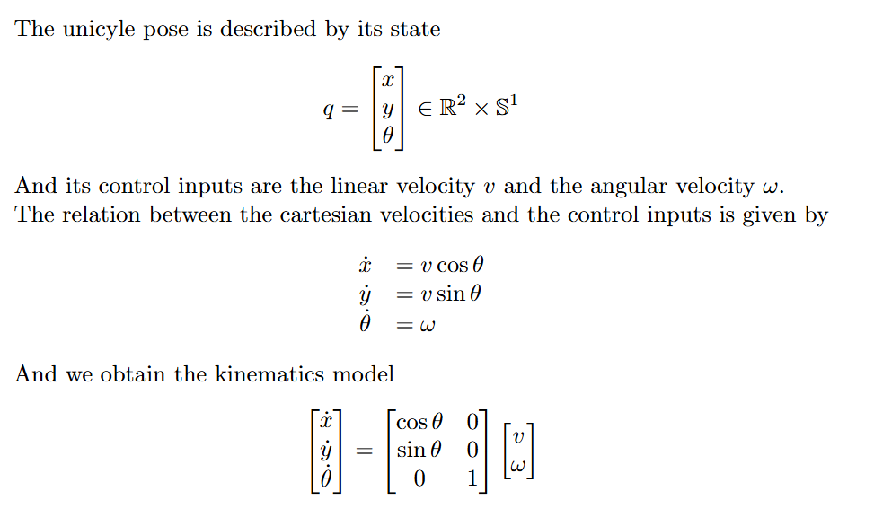
Framework: unicycle
θ
y
The AGV used in the project is a unicycle, a planar vehicle which is described by its state
x

Slide 5
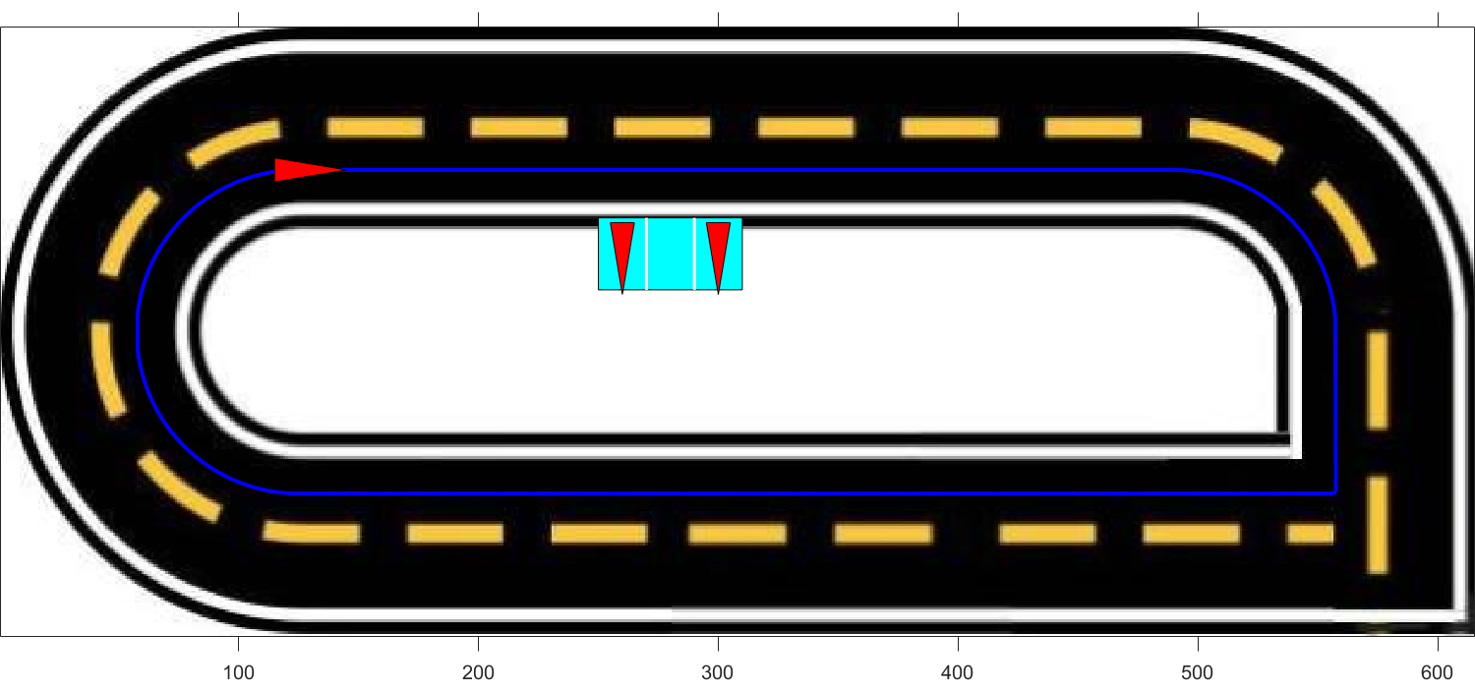
Framework: trajectory
To design the desired trajectory, a series of waypoints was defined. These waypoints were then interpolated using cubic spline interpolation to ensure a continuous path
To test controllers' functionalities on a non-continuous path, a sharp square-angle turn is added to the path

Slide 6
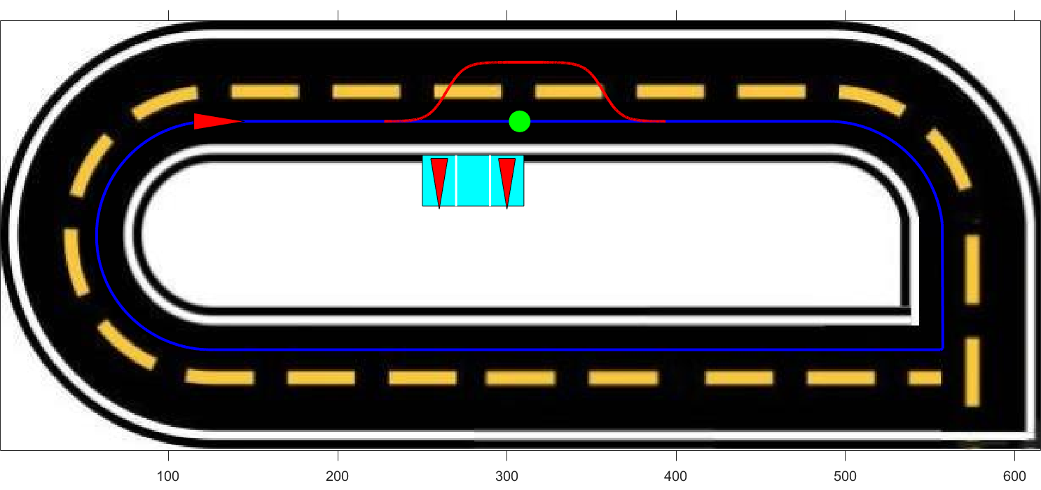
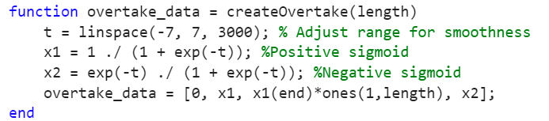
Obstacle avoidance
The unicyle after detecting the obstacle progressively reaches the second lane, after overtaking the obstacle it progressively returns to the first lane
To ensure a smooth and continuous trajectory during the changing lane procedure a sigmoid function has been used

Slide 7
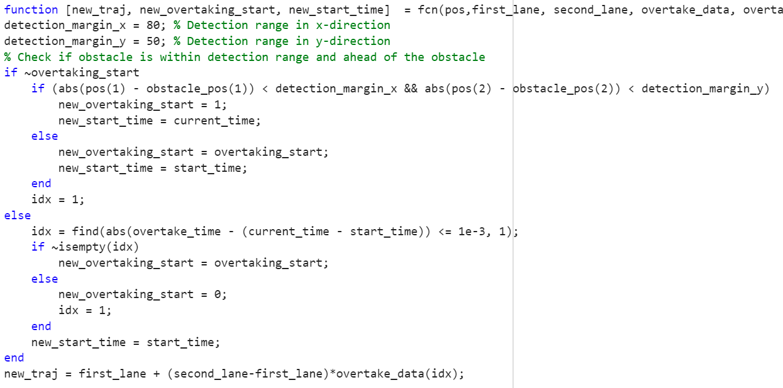
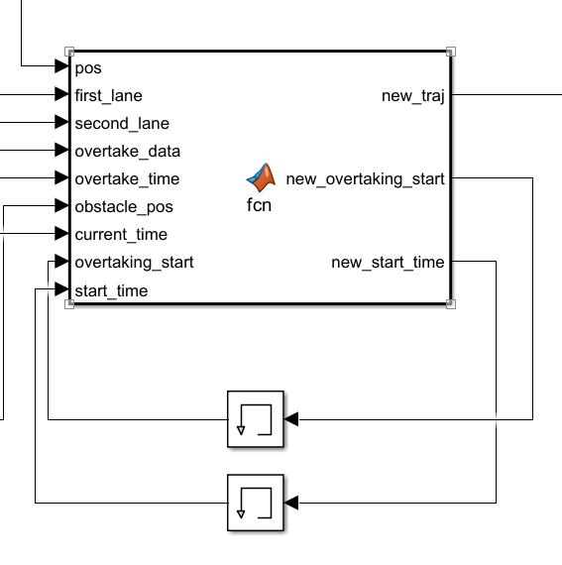
Obstacle avoidance

Slide 8
TRAJECTORY TRACKING - STATE ERROR FEEDBACK

Slide 9
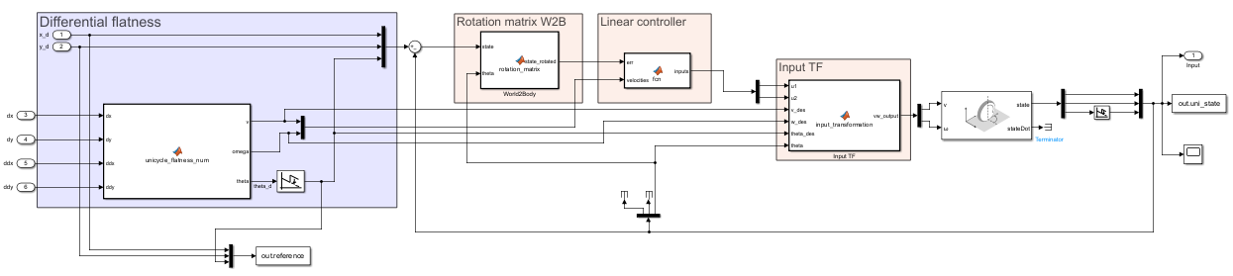
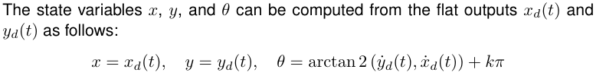
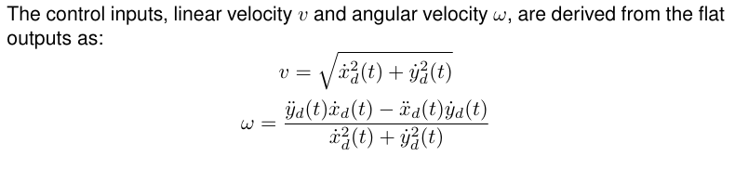
Linear Control
Notes:
THINGS TO SAY:
General overview of the structure, linear controller so based on Eigs allocation
Say that Sigma linear asymp stable → we can only conclude that Sigma NL loc AS
Vdes != 0 , so persistent trajectory (even more important later on with k2 (v is at the denom)
w depends on v^2 basically, so we must have v !=0, furthermore later on , k2=num/vd so vd!=0 otherwise k2 explodes, we will add a saturation on it
explain the wrap / unwrap:
we used the unwrap to normalize theta angle, so we don't have the discontinuity going from 2pi to 0

Slide 10
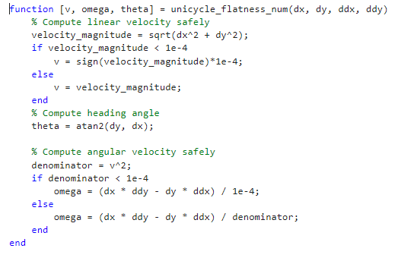
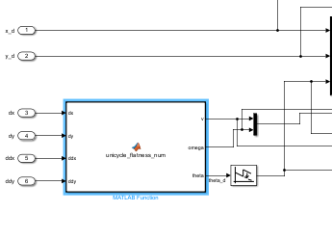
Avoiding division by zero
differential flatness block

Slide 11
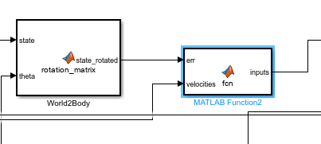
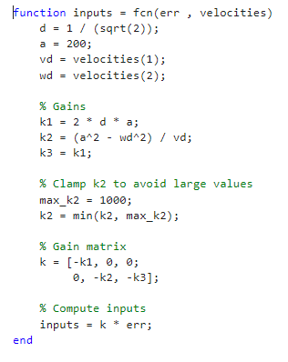
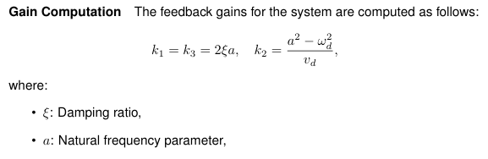
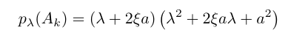
Controller design
Put controller formulas , u1 u2
Epsilon between 0 and 1 , a >0
Edot = A *e e mettere A
Notes:
We can not guarantee asymp convergence cause K2 (system) TV, but we do have convergence property cause we are doing rectilinear and semicircular motions so someway we are covered by good convergence properties
Say something about eigenvalues, thanks to this ki we know the eigs are on the LHS

Slide 12
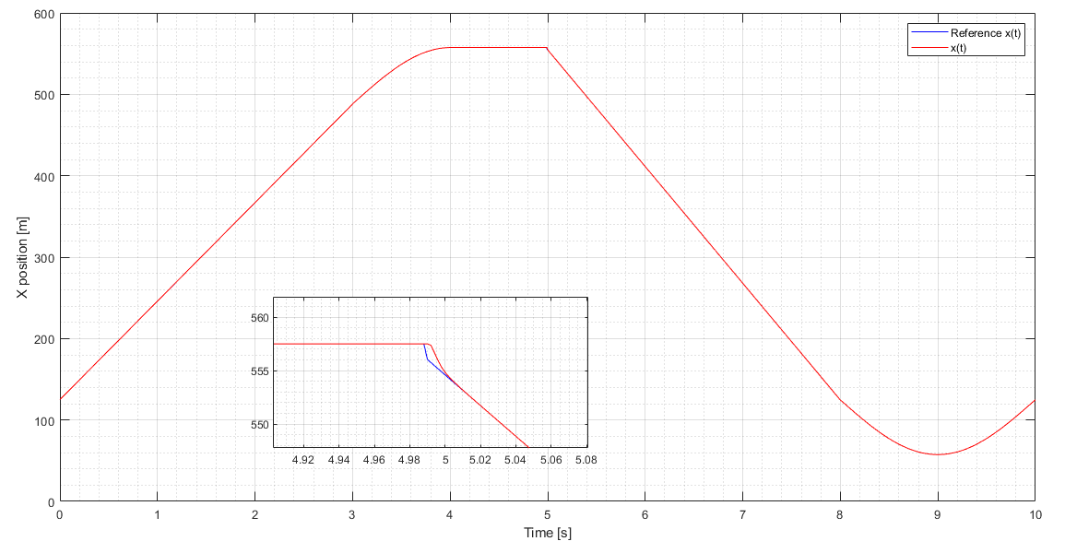
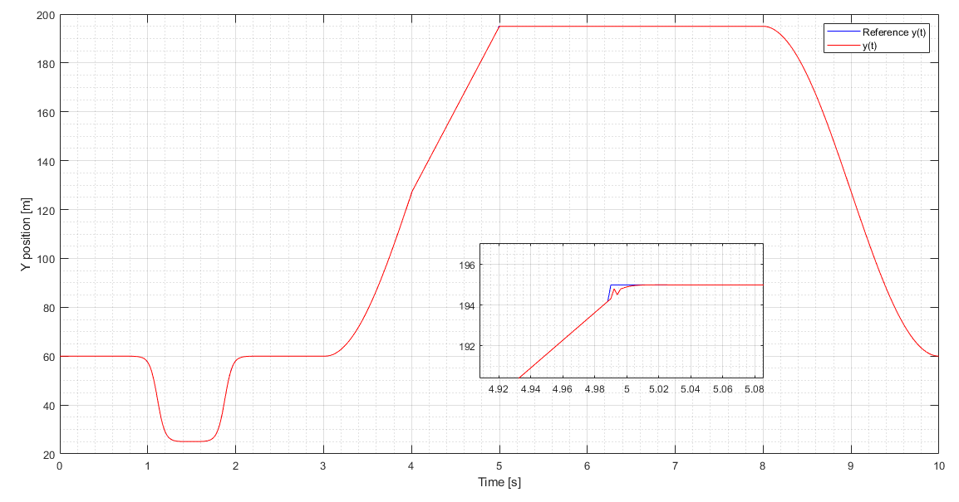

Slide 13
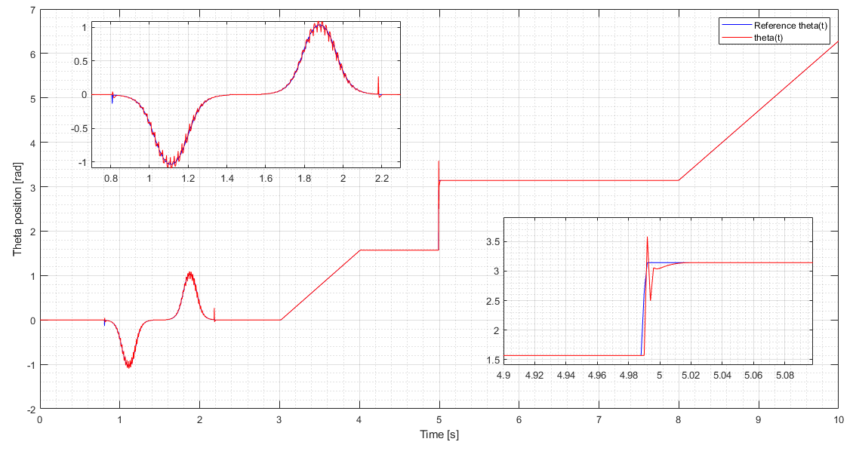

Slide 14
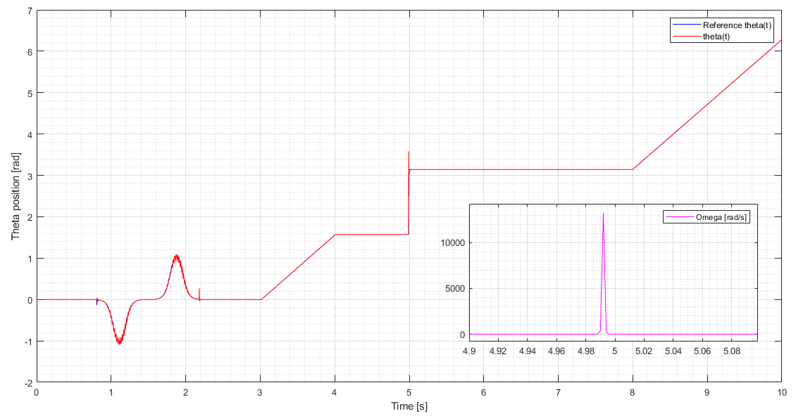
Focus on sharp curve
differential flatness block should not be able to compute the input velocities when reaching a non differentiable part of the trajectory. Indeed, impulses in both velocities arises, with stronger effect in omega, (its computation is based on the second order derivative).
Nonetheless, thanks to saturator blocks on omega and gains we are able to overcome the problem and to finish the simulation anyway.

Slide 15
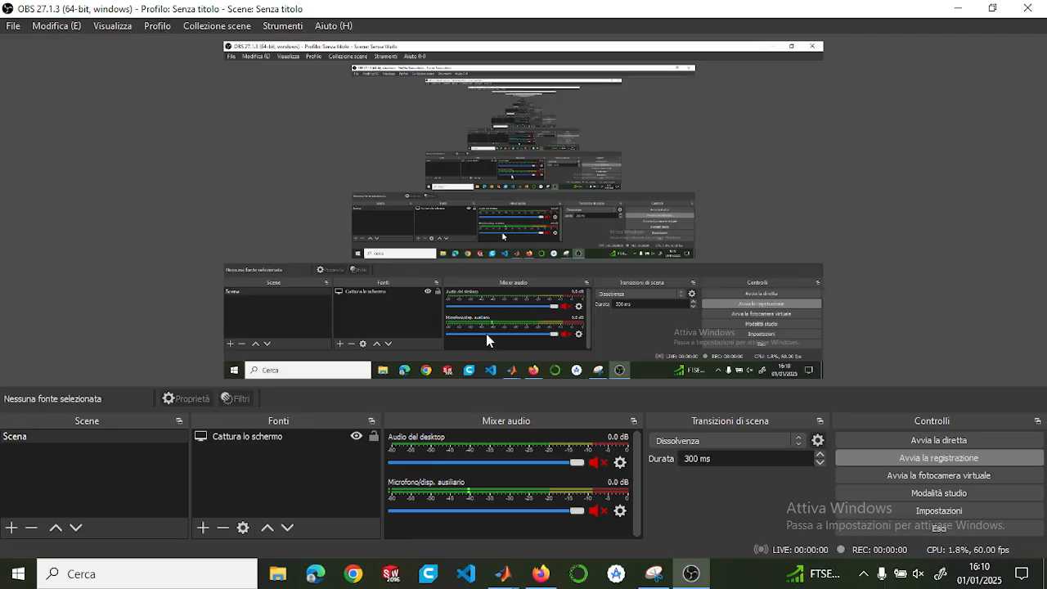
Video
Sistemare e tagliare video

Slide 16
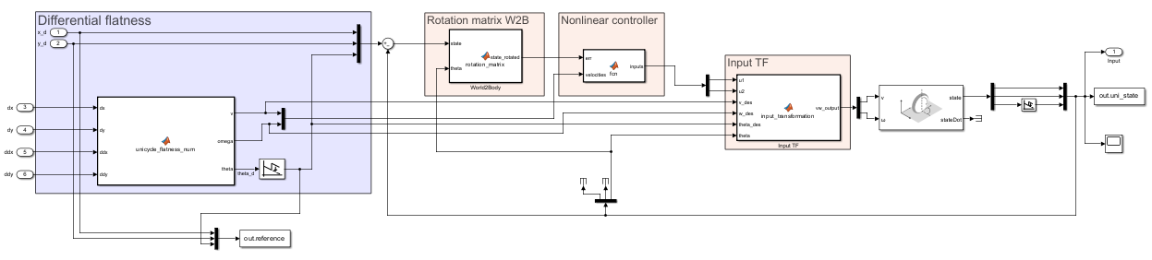
Non Linear Control
Notes:
THINGS TO SAY:
General overview of the structure and vdes!=0 → same as before cause its related with diff flatness
Highlights the same nature of the structure, with the only difference : gain computation and feedback law
Barbalat’s lemma problem. Before we had no convergence guarantees cause k2 TV , now instead we could end up with loosing conv property cause w could become unbounded and hence Barb no true anymore -→ this is what we stress out in the sharp curve
explain the wrap / unwrap:
we used the unwrap to normalize theta angle, so we don't have the discontinuity going from 2pi to 0

Slide 17
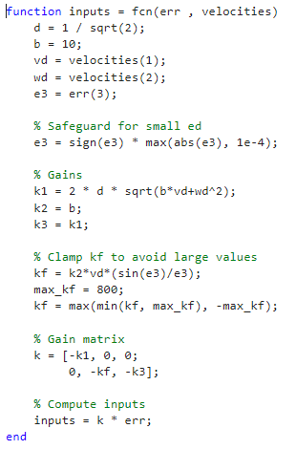
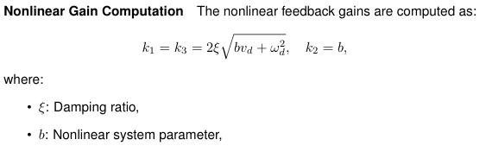
Controller design
Put controller formulas , u1 u2
Lyap arguments
Epsilon tra 0 e 1 , b >0 , legame b e a
Notes:
Highlight the relation between a and b , could we also compute eigs for this ? Is b a natural freq too ?

Slide 18
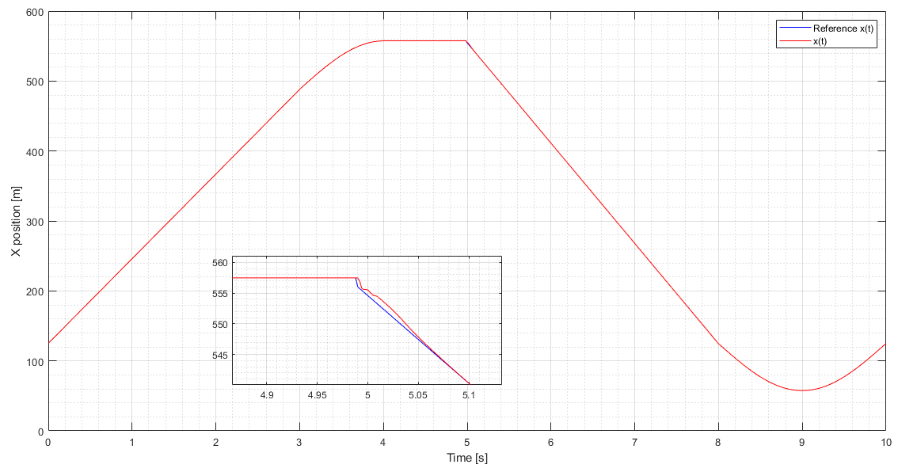
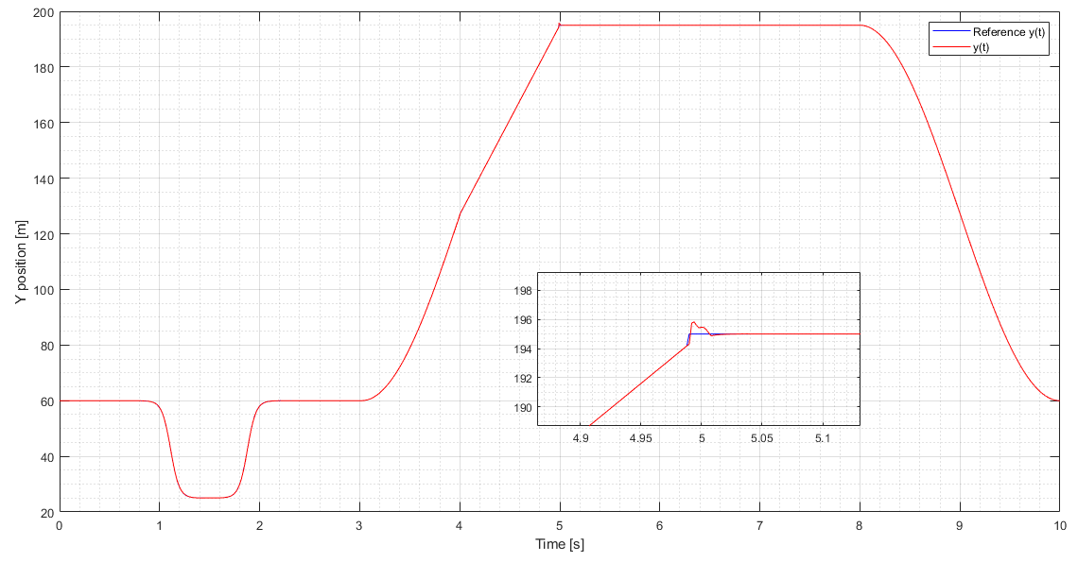

Slide 19
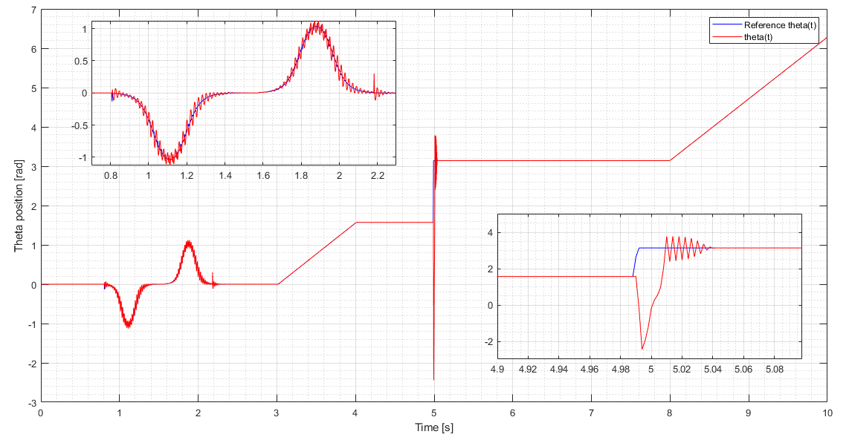
Plots --> see if impulse bigger than linear case follows some theoretical thing or just related to gains tuning
D = 1/sqrt(2)
B=10

Slide 20
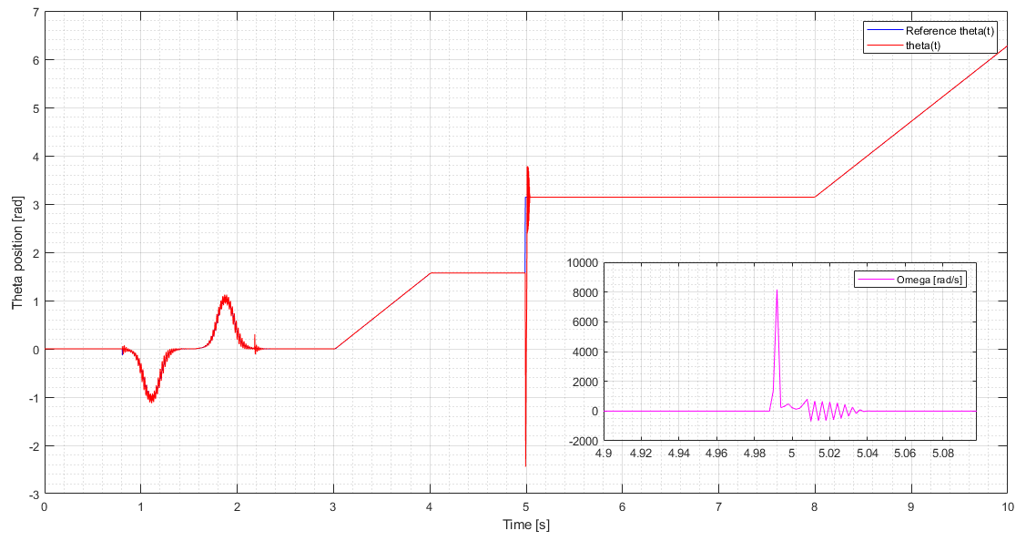
Focus on sharp curve
Make a consideration regarding NL more enhanced wrt lineare case, maybe theres a reason
D = 1/sqrt(2)
B=10

Slide 21
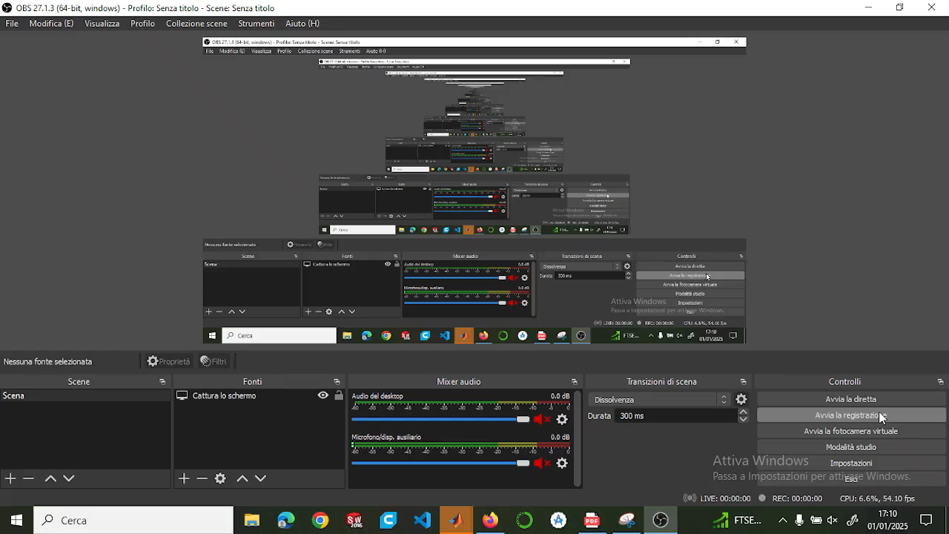
Video
Sistemare e tagliare video

Slide 22
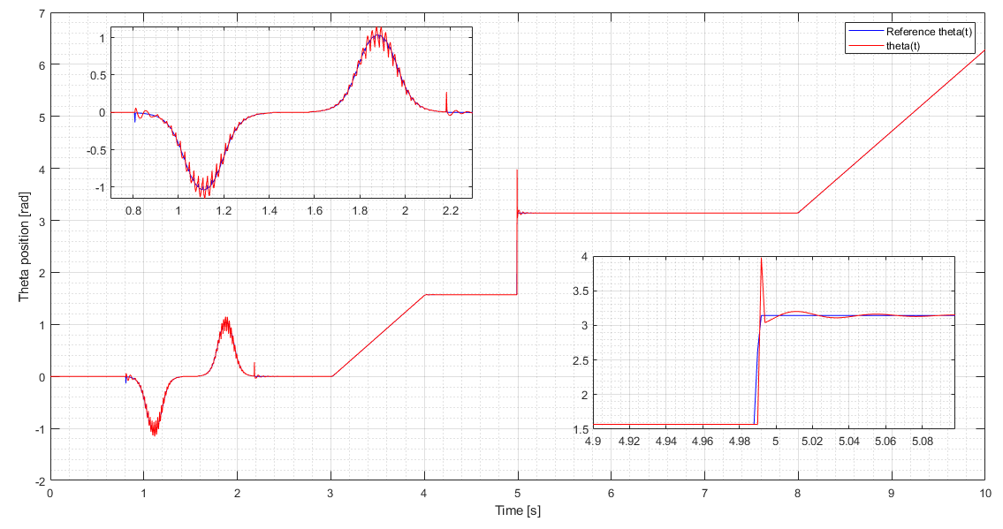
D = 2/sqrt(2)
B=1

Slide 23
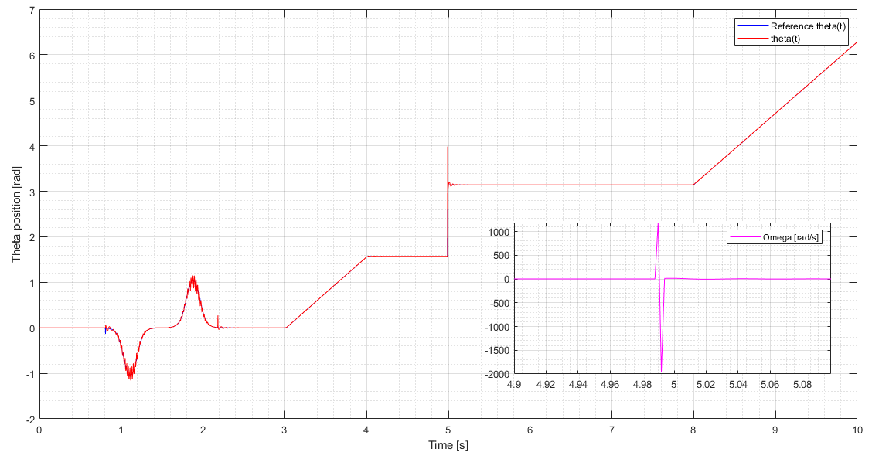
D = 2/sqrt(2)
B=1

Slide 24
Video
Sistemare e tagliare video
Put video with this new gains

Slide 25
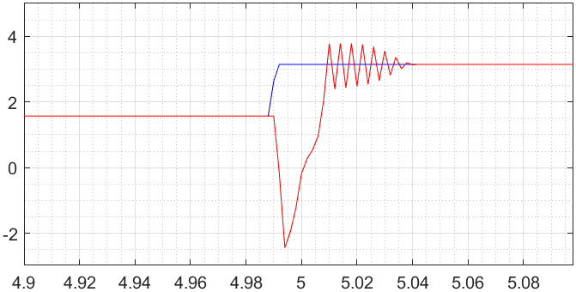
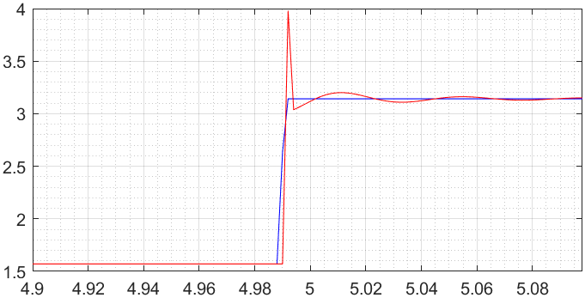
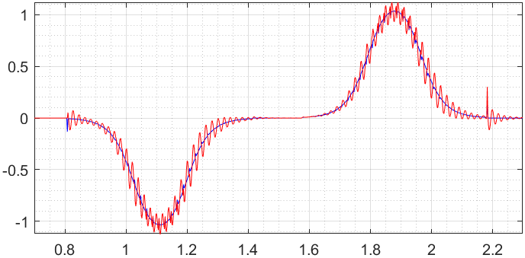
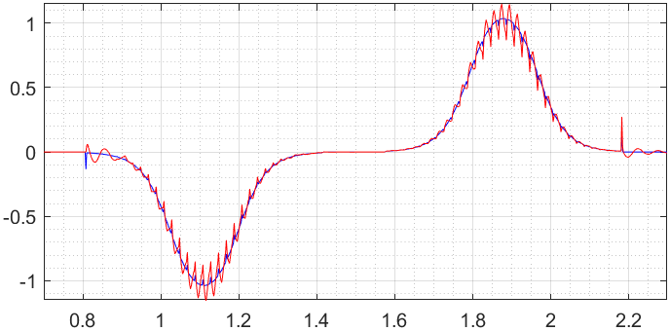
D = 1/sqrt(2)
B=10
D = 2/sqrt(2)
B=1
less aggressive , less reactive but more stable
More aggressive , more reactive

Slide 26
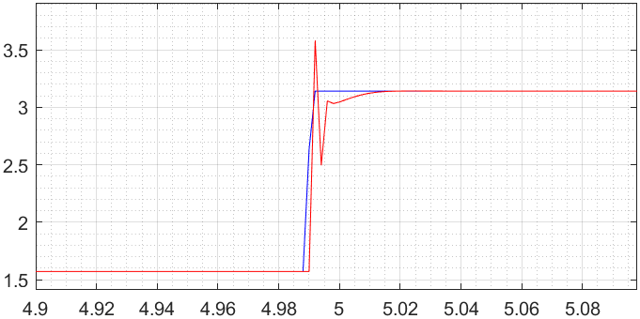
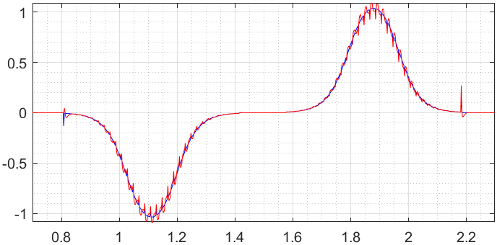

Slide 28
Qualche breve considerazione finale sui due controllori, che poi verrà ripresa meglio alla fine della presentazione

Slide 29
TRAJECTORY TRACKING - OUTPUT ERROR FEEDBACK

Slide 30
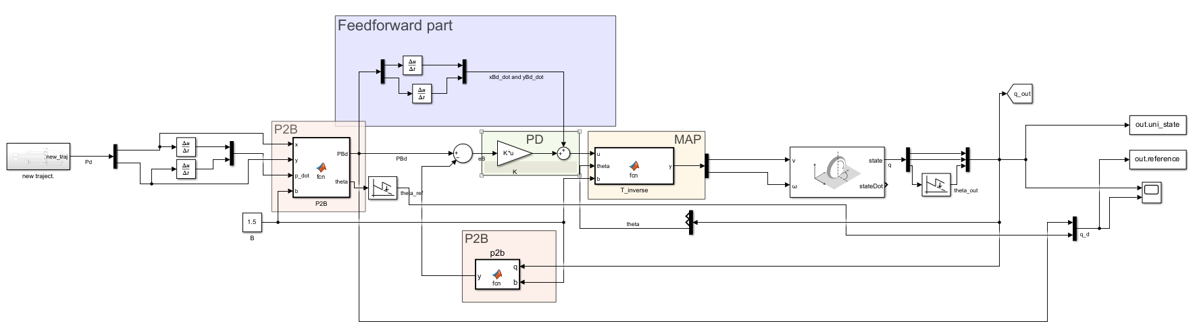
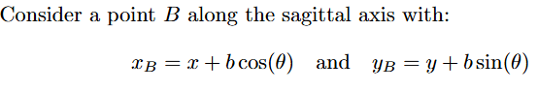
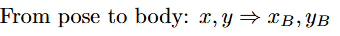
Feedback linearization based on a reference point on the sagittal axis

Slide 31
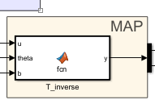
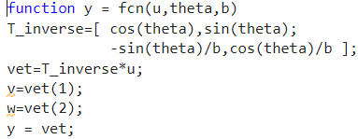
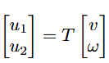
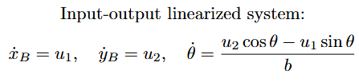
Map

Slide 32
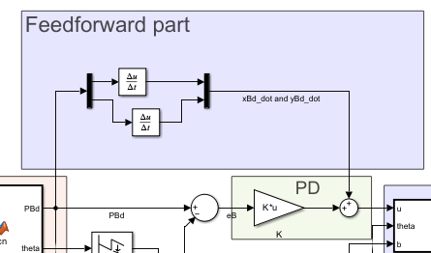
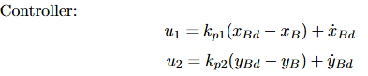
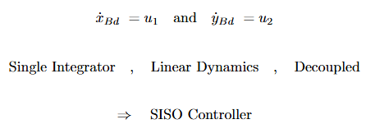
Controller design
Pro:

Slide 33
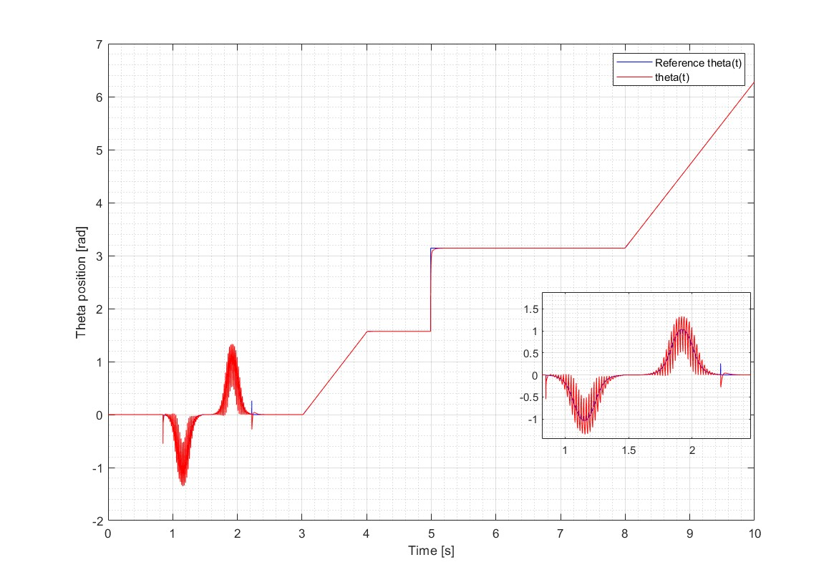
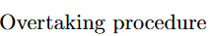
Plot

Slide 34
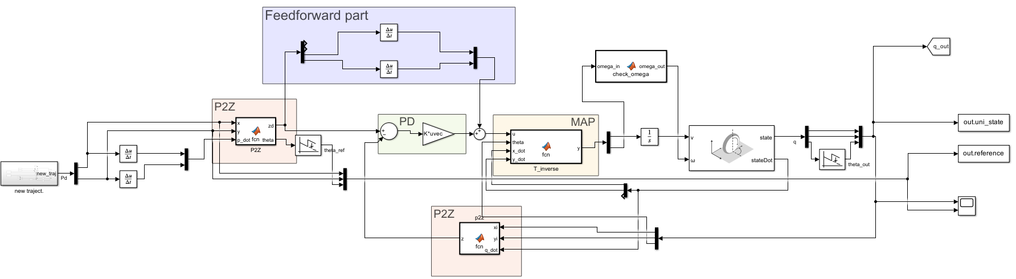
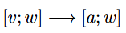

Feedback linearization based on second order derivatives

Slide 35




Map

Slide 36



Controller design
Need:

Slide 37

Plot

Slide 38


Plot

Slide 39
REGULATION

Slide 40


Cartesian regulation

Slide 41



Control law

Slide 42

Pose regulation

Slide 43


State trasformation

Slide 44


Control law

Slide 45

Plots of all controllers together

Slide 46


Slide 47


